Slide 1
Silo RF Analysis

Slide 2
Cellular
TV
Cellular
Outside
WiFi
Exterior Baseline
Outside
WiFi
Silo (Doors Closed)

Slide 3
Silo (Doors Open)
Outside
WiFi
Silo (Doors Closed)

Slide 4
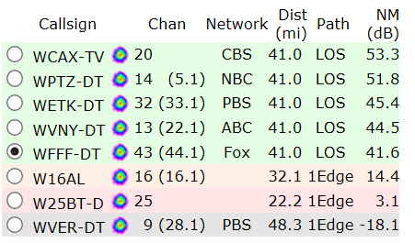
506-512 MHz
470-476 MHz
578-584 MHz
174-180 MHz
602-608 MHz
482-488 MHz
536-542 MHz
186-192 MHz
WCAX
WPTZ
Cellular
W16AL
W25BT
WFFT

Slide 5
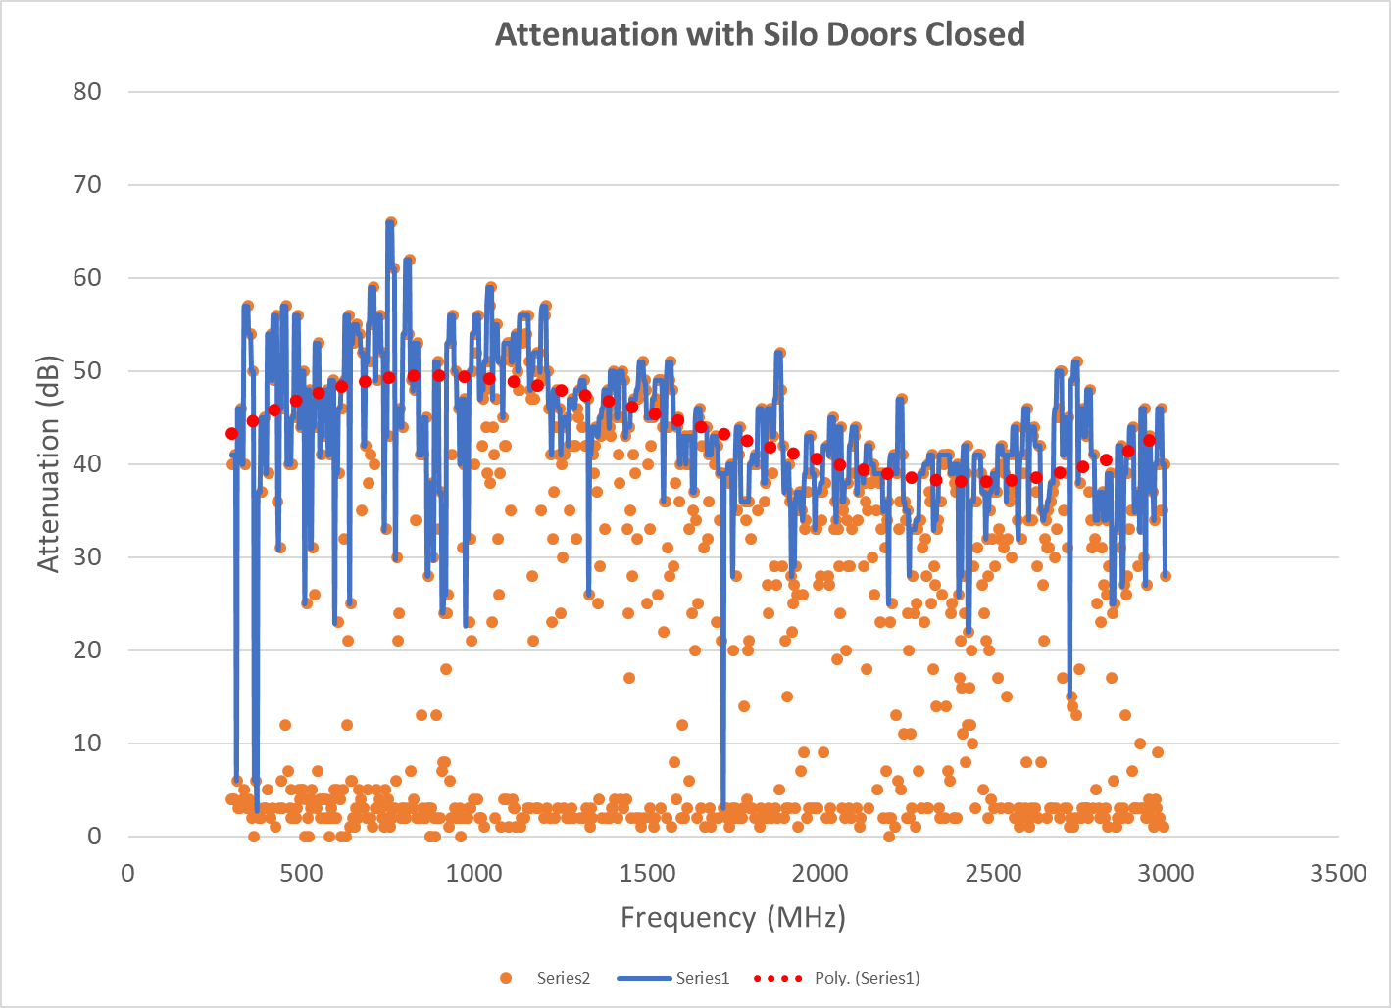

Slide 6
Unlicensed
Source
Interior
WiFi
Cellular
TBD
“Faraday Room”
Unlicensed Source

Slide 7
Unlicensed
Source
Scanning Signal
WiFi
From Laptop
Interior
WiFi
Cellular
TBD
Antenna Silo
(Open)
Antenna Silo
(Closed)

Slide 8
Scanning (500-3000 MHz)
Silo –
Access Tunnel –
Silo Deck +
Doors Open (sweep))
Scanning (500-3000 MHz)
~15 dB Isolation
Silo –
Access Tunnel –
Silo Deck
Doors Closed (sweep)
Scanning Signal
Scanning (500-3000 MHz)
Silo –
Access Tunnel –
Silo Deck +
Outer Doors Closed (sweep)
~45 dB Isolation
Scanning (500-3000 MHz)
Silo –
Lower Control Room –
Silo Deck +
Outer Doors Closed (sweep)
~60 dB Isolation

Slide 9
Silo –
Access Tunnel –
Silo Deck + Doors Open
510 MHz Probe (-70 dBm)
Silo –
Access Tunnel –
Silo Deck Doors Closed
510 MHz Probe (-70 dBm)
Silo –
Access Tunnel –
Silo Deck +
Outer Doors Closed (2)
510 MHz Probe (-88 dBm)

Slide 10
510 MHz Probe (-77 dBm)
Silo –
Control Room - Doors Open
510 MHz Probe (-82 dBm)
Silo –
Control Room –
Control Room Door Closed
510 MHz Probe (-84 dBm)
Silo –
Control Room –
Silo Deck Door Closed
510 MHz Probe (-90 dBm)
Silo –
Control Room –
Silo Deck +
Outer Doors Closed

Slide 11
